Slide 1

Introduction to CUDA (8) Parallel Pattern: Sparse Matrix
Parallel Computing

Slide 2
Content
Background
Parallel SpMV Using CSR
Padding and Transposition
Hybrid Approach to Regulate Padding
Sorting and Partitioning for Regularization

Slide 3
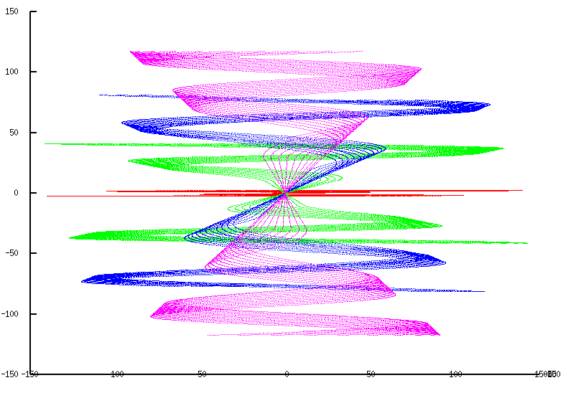
Sparse Data Motivation for Compaction
很多现实世界的输入数据都是稀疏的
sparse/non-uniform
信号采样，
网格模型，
交通网络，
通信网络等。

Slide 4
Science Area | Number of Teams | Codes | Struct Grids | Unstruct Grids | Dense Matrix | Sparse Matrix | N-Body | Monte Carlo | FFT | PIC | Sig I/O
Climate and Weather | 3 | CESM, GCRM, CM1/WRF, HOMME | X | X |  | X |  | X |  |  | X
Plasmas/ Magnetosphere | 2 | H3D(M),VPIC, OSIRIS, Magtail/UPIC | X |  |  |  | X |  | X |  | X
Stellar Atmospheres and Supernovae | 5 | PPM, MAESTRO, CASTRO, SEDONA, ChaNGa, MS-FLUKSS | X |  |  | X | X | X |  | X | X
Cosmology | 2 | Enzo, pGADGET | X |  |  | X | X
Combustion/ Turbulence | 2 | PSDNS, DISTUF | X |  |  |  |  |  | X
General Relativity | 2 | Cactus, Harm3D, LazEV | X |  |  | X
Molecular Dynamics | 4 | AMBER, Gromacs, NAMD, LAMMPS |  |  |  | X | X |  | X
Quantum Chemistry | 2 | SIAL, GAMESS, NWChem |  |  | X | X | X | X |  |  | X
Material Science | 3 | NEMOS, OMEN, GW, QMCPACK |  |  | X | X | X | X
Earthquakes/ Seismology | 2 | AWP-ODC, HERCULES, PLSQR, SPECFEM3D | X | X |  |  | X |  |  |  | X
Quantum Chromo Dynamics | 1 | Chroma, MILC, USQCD | X |  | X | X
Social Networks | 1 | EPISIMDEMICS
Evolution | 1 | Eve
Engineering/System of Systems | 1 | GRIPS,Revisit |  |  |  |  |  | X
Computer Science | 1 |  |  | X | X | X |  |  | X |  | X

Slide 5
Challenges
稀疏矩阵乘法（SpMV）与稠密矩阵乘法的比较
Is irregular/unstructured
Has little input data reuse
Benefits little from compiler transformation tools
如何实现性能最大化？
Maximize regularity (by reducing divergence and load imbalance)
Maximize DRAM burst utilization (layout arrangement)

Slide 6
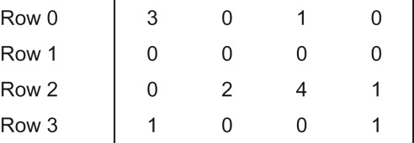
A Simple Parallel SpMV
Ax+Y=0
矩阵的每一行对应线性系统中的一个方程。
How to solve x?

Slide 7
A Simple Parallel SpMV
Ax+Y=0
How to solve x? -- Direct method
X=A⁻¹Y
需要对系数矩阵求逆
传统的求逆算法，如高斯消元法，可能会产生太多的“填充”元素，并使矩阵的尺寸爆炸性增长。

Slide 8
A Simple Parallel SpMV
Ax+Y=0
How to solve x? -- Iterative method (CG)
Ax+Y
If x^{T}Ax > 0
共轭梯度法（conjugate gradient, CG)是常用方法
计算涉及到稀疏矩阵乘法和加法
Sparse Matrix-Vector Multiplication (SpMV)

Slide 9
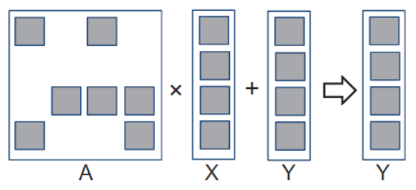
SpMV
Main task in CG:
稀疏矩阵乘法和加法
并行解决方案:
一个线程处理一行?

Slide 10
A Simple Parallel SpMV
Main task in CG:
稀疏矩阵乘法和加法
Thread 0
Thread 1
Thread 2
Thread 3
主要挑战:
Storage and bandwidth considerations
需要一种好的表示（排列）格式，避免过多零元素带来的问题

Slide 11
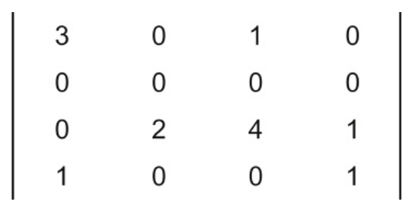
Compressed Sparse Row (CSR) Format
CSR: 只将非零元素存在一维存储。
 |  |  | Row 0 |  |  | Row 2 |  |  |  | Row 3
Nonzero values | data[7] | { | 3, | 1, |  | 2, | 4, | 1, |  | 1, | 1 | }
Column indices | col_index[7] | { | 0, | 2, |  | 1, | 2, | 3, |  | 0, | 3 | }
Row Pointers | ptr[5] | { | 0, 2, 2, 5, 7 }
每行的非零元素在data中的的起始位置

Slide 12
CSR Data Layout
每行的非零元素在data中的的起始位置
row_ptr
0
2
2
5
7
data
3
1
2
4
1
1
1
col_index
0
2
1
2
3
0
3

Slide 13

A sequential SpMV /CSR
for (int row = 0; row < num_rows; row++)
{
2. float dot = 0;
3. int row_start = row_ptr[row];
4. int row_end = row_ptr[row+1];
for (int elem = row_start; elem < row_end; elem++)
{
6. dot += data[elem] * x[col_index[elem]];
}
7. y[row] += dot;
}

Slide 14
Content
Background
Parallel SpMV Using CSR
Padding and Transposition
Hybrid Approach to Regulate Padding
Sorting and Partitioning for Regularization

Slide 15
CSR Kernel Design
ptr
CSR Format

Slide 16
A Parallel SpMV/CSR Kernel (CUDA)
__global__ void SpMV_CSR( int num_rows, float *data,
int *col_index, int *row_ptr, float *x, float *y) {
2. int row = blockIdx.x * blockDim.x + threadIdx.x;
3. if (row < num_rows) {
4. float dot = 0;
5. int row_start = row_ptr[row];
6. int row_end = row_ptr[row+1];
7. for (int elem = row_start; elem < row_end; elem++) {
8. dot += data[elem] * x[col_index[elem]];
}
9. y[row] = dot;
}
}
 |  |  | Row 0 |  |  | Row 2 |  |  |  | Row 3
Nonzero values | data[7] | { | 3, | 1, |  | 2, | 4, | 1, |  | 1, | 1 | }
Column indices | col_index[7] | { | 0, | 2, |  | 1, | 2, | 3, |  | 0, | 3 | }
Row Pointers | ptr[5] | { | 0, 2, 2, 5, 7 }

Slide 17
CSR Kernel Memory Divergence
相邻的线程读取不相邻（ non-adjacent ）的存储位置
Grey elements are accessed by all threads in iteration 0
row_ptr
0
2
2
5
7
data
3
1
2
4
1
1
1
col_index
0
2
1
2
3
0
3
Memory Divergence

Slide 18
CSR Kernel Control Divergence
在for循环中，线程执行不同的迭代次数
row_ptr
0
2
2
5
7
data
3
1
2
4
1
1
1
col_index
0
2
1
2
3
0
3
Control Divergence

Slide 19
CSR Kernel Data Dependence
并行SpMV计算效率和内存带宽效率：
依赖于输入矩阵的分布
稀疏分布的情况在实际应用中常见.
row_ptr
0
2
2
5
7
data
3
1
2
4
1
1
1
col_index
0
2
1
2
3
0
3

Slide 20
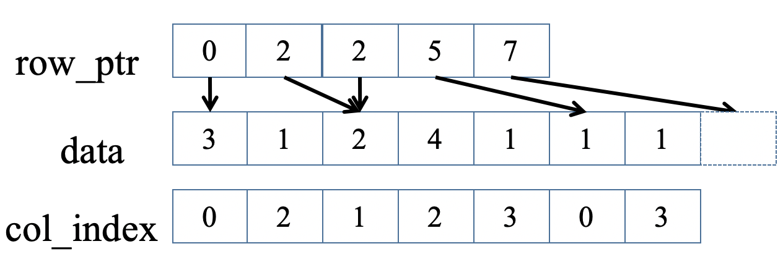
SpMV / CSR
Advantages
去除了0元素的存储.
因此也避免从存储器中读取0元素.
因此也避免了无用的0元素乘法.
Disadvantages
需要额外存储col_index 和 row_ptr 数组.
没有实现内存读取的合并（coalesced）.
有可能在所有Warp中引发严重的控制流分歧（divergence）.

Slide 21
Content
Background
Parallel SpMV Using CSR
Padding and Transposition
Hybrid Approach to Regulate Padding
Sorting and Partitioning for Regularization

Slide 22
ELL storage format
ELL: ELLPACK.
针对non-coalesced 存储读取和 control divergence，对数据进行 padding 和 transposition处理。
Dummy Zero
3
1
*
3
*
2
1
*
*
*
1
*
4
1
2
4
1
*
*
1
*
1
1
*
CSR with Padding
Transposed

Slide 23
SpMV / ELL
补齐（Pad）所有行到相同的长度；
转置Transpose (Column Major) 以便提高DRAM 效率；
3
1
*
Thread 0
Thread 1
Thread 2
Thread 3
*
*
*
3
*
2
1
2
4
1
1
*
4
1
1
1
*
*
*
1
*
CSR with Padding
Transposed
Both data and col_index padded/transposed

Slide 24
ELL Kernel Design
*
*
*
*
*
*
*
*
*
*
*
*
*
*
*
*
*
*
*
*
*
*
*
*
*
*
CSR with Padding
A
ELL Format

Slide 25
A parallel SpMV/ELL kernel
__global__ void SpMV_ELL( int num_rows, float *data,
int *col_index, int num_elem, float *x, float *y)
{
2. int row = blockIdx.x * blockDim.x + threadIdx.x;
3. if (row < num_rows) {
4. float dot = 0;
5. for (int i = 0; i < num_elem; i++) {
6. dot += data[row+i*num_rows]*x[col_index[row+i*num_rows]];
}
7. y[row] = dot;
}
}

Slide 26
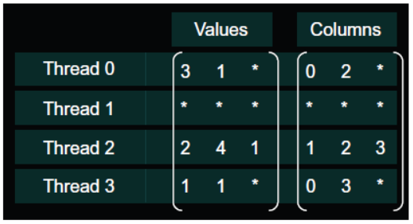
Memory Coalescing with ELL
Thread 0
Thread 1
Thread 2
Thread 3
data
3
*
2
1
1
*
4
1
*
*
1
0
*
1
0
2
*
2
3
*
*
3
col_index
row_ptr is no longer need

Slide 27
SpMV / ELL
Advantages
合并式内存访问。
所有相邻线程现在都在访问相邻的内存位置；
在线程束中没有控制流发散。
所有线程现在在点积循环中完全迭代相同的次数。
Disadvantages
如果某些行比其他行长得多，则效率低下.
1000×1000 的稀疏矩阵有 1% 的元素是非零值:
每行有 10 个非零元素；
几行有 200 个非零值，而所有其他行的非零值都少于 10.

Slide 28
Content
Background
Parallel SpMV Using CSR
Padding and Transposition
Hybrid Approach to Regulate Padding
Sorting and Partitioning for Regularization

Slide 29
Coordinate (COO) format
显式列出每个非零元素的行号和列号：
 |  |  | Row 0 |  |  | Row 2 |  |  |  | Row 3
Nonzero values | data[7] | { | 3, | 1, |  | 2, | 4, | 1, |  | 1, | 1 | }
Column indices | col_index[7] | { | 0, | 2, |  | 1, | 2, | 3, |  | 0, | 3 | }
Row indices | row_index[7] | { | 0, | 0, |  | 2, | 2, | 2, |  | 3, | 3 | }

Slide 30
COO Allows Reordering of Elements
 |  |  | Row 0 |  |  | Row 2 |  |  |  | Row 3
Nonzero values | data[7] | { | 3, | 1, |  | 2, | 4, | 1, |  | 1, | 1 | }
Column indices | col_index[7] | { | 0, | 2, |  | 1, | 2, | 3, |  | 0, | 3 | }
Row indices | row_index[7] | { | 0, | 0, |  | 2, | 2, | 2, |  | 3, | 3 | }
Re-order
Nonzero values | data[7] | { | 1 | 1, | 2, | 4, | 3, | 1 | 1 | }
Column indices | col_index[7] | { | 0 | 2, | 1, | 2, | 0, | 3, | 3 | }
Row indices | row_index[7] | { | 3 | 0, | 2, | 2, | 0, | 2, | 3 | }

Slide 31
SpMV/COO
1. for (int i = 0; i < num_elem; row++)
2. y[row_index[i]] += data[i] * x[col_index[i]];
A sequential loop that implements SpMV/COO
最终计算结果的正确性与处理这些元素的顺序无关。

Slide 32
COO Kernel Design Accessing Input Matrix and Vector
x
v
Ax = v
All threads can access matrix and row_index, each using the accessed col_index to access vector
Maximal parallelism..
Row
Col
Data
A
COO Storage Format

Slide 33
COO kernel Design Accumulating into Output Vector
x
v
Ax = v
Each threads uses the row_index of its element to accumulate into one of the output Y elements
Need atomic operations!
Row
Col
Data
A

Slide 34
SpMV / COO
Advantages
更灵活.
Disadvantages
需要额外存储一个行索引（ row_index ）数组；
Need atomic operations.

Slide 35
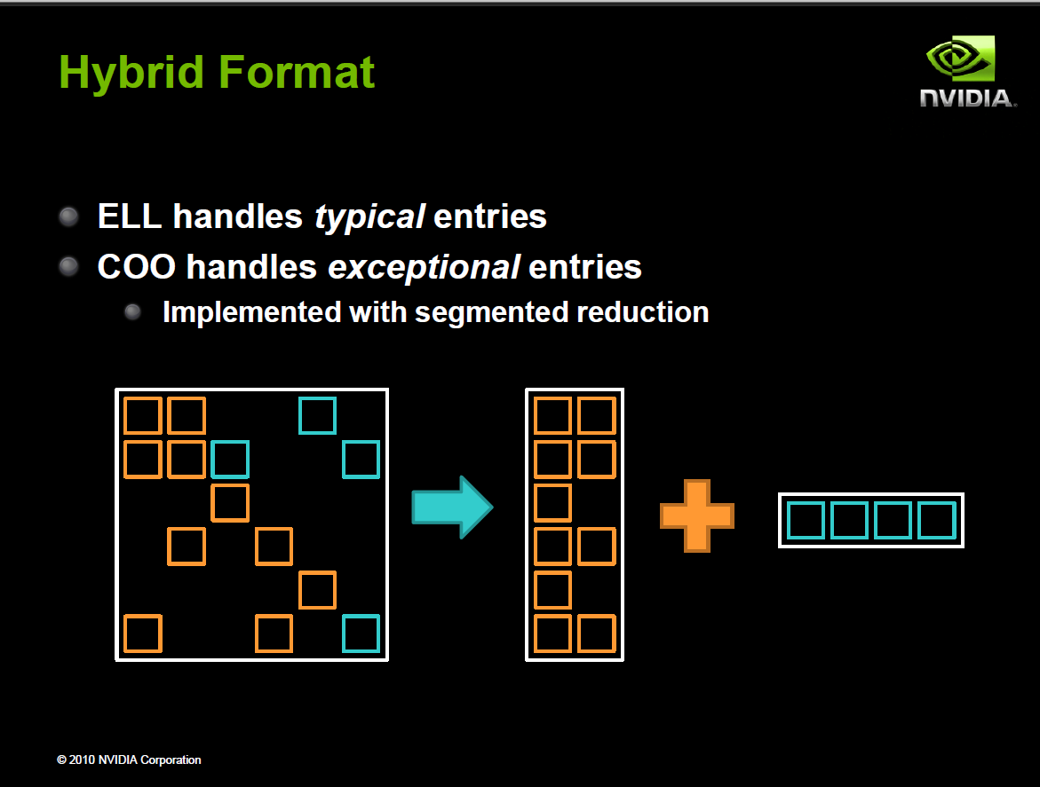
Often implemented in sequential host code in practice

Slide 36
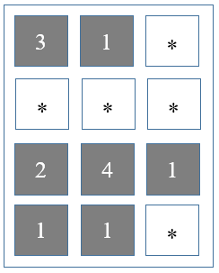
Reduced Padding with Hybrid Format
 |  | data |  |  | col_index
Thread 0 |  | 3 | 1 |  | 0 | 2
Thread 1 |  | * | * |  | * | *
Thread 2 |  | 2 | 4 |  | 1 | 2
Thread 3 |  | 1 | 1 |  | 0 | 3
Thread 0
Thread 2
Thread 1
Thread 3
Iteration 0
data
3
*
2
1
1
*
4
1
data
1
col_index
3
index
0
*
1
0
2
*
2
3
row_index
2
ELL
COO

Slide 37
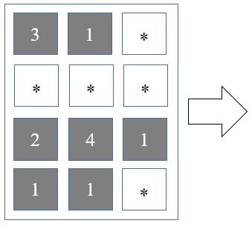
Reduced Padding with Hybrid Format
 |  | data |  |  | col_index
Thread 0 |  | 3 | 1 |  | 0 | 2
Thread 1 |  | * | * |  | * | *
Thread 2 |  | 2 | 4 |  | 1 | 2
Thread 3 |  | 1 | 1 |  | 0 | 3
补齐元素的数量，从5减少到2.
更为重要的是，所有线程只需迭代2次而不是3次。

Slide 38
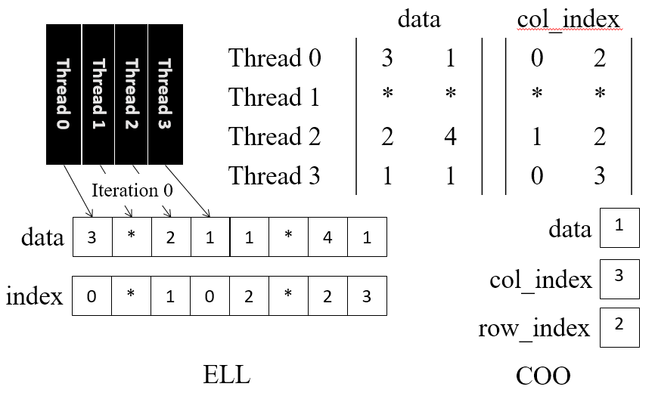
Question
Host端额外将 COO 元素从 ELL 格式中分离出来的工作是否会带来过多的开销？
在迭代求解器中，稀疏矩阵-向量乘（SpMV）操作会在相同的稀疏内核上反复执行。平均了开销。

Slide 39
SpMV / Hybrid Format
Advantages
Avoid large number of zero padding by regularization.
CPU+GPU
Disadvantages
Non-load-balance.
ptr

Slide 40
Content
Background
Parallel SpMV Using CSR
Padding and Transposition
Hybrid Approach to Regulate Padding
Sorting and Partitioning for Regularization

Slide 41
JDS (Jagged Diagonal Sparse) Kernel Design for Load Balancing
Sort rows into descending order according to number of non-zero.
JDS Format

Slide 42
JDS (Jagged Diagonal Sparse) Kernel Design for Load Balancing
Perm with
jds_row_index
Access with
col_index
根据非零元素的数量将行按降序排列。
跟踪原始行号，以便可以正确生成输出向量。 jds_row_index
JDS Format

Slide 43
Sorting Rows According to Length (Regularization)
jds_row_index
3
1
2
4
1
Row 2
3
1
Row 0
2
4
1
1
1
Row 3
1
1
Row 1
CSR
JDS

Slide 44
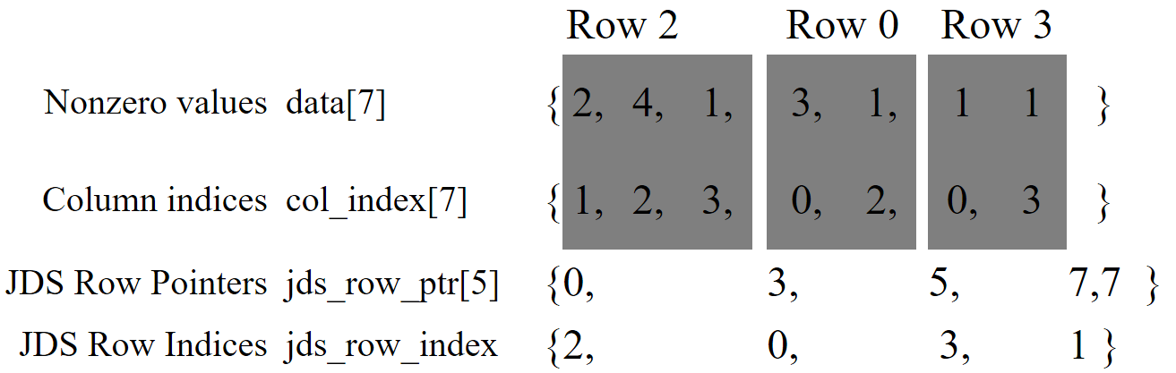
A Parallel SpMV/JDS Kernel
__global__ void SpMV_JDS(int num_rows, float *data,
int *col_index, int *jds_row_ptr,int jds_row_index,
float *x, float *y) {
2. int row = blockIdx.x * blockDim.x + threadIdx.x;
3. if (row < num_rows) {
4. float dot = 0;
5. int row_start = jds_row_ptr[row];
6. int row_end = jds_row_ptr[row+1];
7. for (int elem = row_start; elem < row_end; elem++) {
8. dot += data[elem] * x[col_index[elem]];
}
9. y[jds_row_index[row]] = dot;
}
}

Slide 45
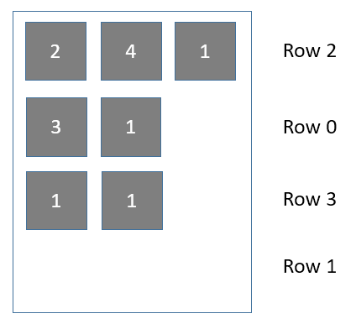
Divide into sections
Section 1
Section 2
Section 3
在每个section内，我们只需要对行进行填充（补齐），使其与该部分中元素数量最多的行相匹配。

Slide 46
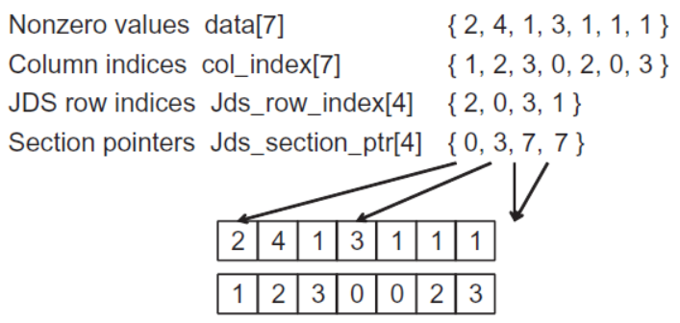
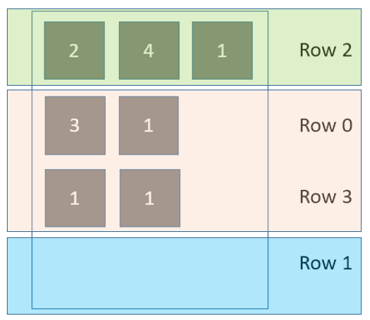
JDS format and sectioned ELL
然后我们可以独立地转置（ transpose ）每个section，
并在每个section上启动一个单独的Kernel。

Slide 47
Questions
对行进行排序是否会得到错误的结果？
不会。
唯一的额外步骤是使用 jds_row_index 数组将最终解重新排序回原始顺序。
排序是否会产生显著的开销？
迭代方法。平摊开销

Slide 48
Take advantages of New Devices
在相对较新的设备中：
内存合并硬件放宽了地址对齐（coalescing）要求，
允许简单地转置 JDS-CSR 表示法。
在实践中：
虽然分段的 JDS-ELL 在较旧的 CUDA 设备上往往表现出最佳性能，
但转置的 JDS-CSR 在 Fermi 和 Kepler 上往往表现出最佳性能。

Slide 49
SpMV Summary
在并行稀疏方法中用于压缩输入数据的关键技术，以减少对内存带宽的消耗：
更好地利用片上内存，
减少传输到片上内存的字节数，
保持规律性。

Slide 50
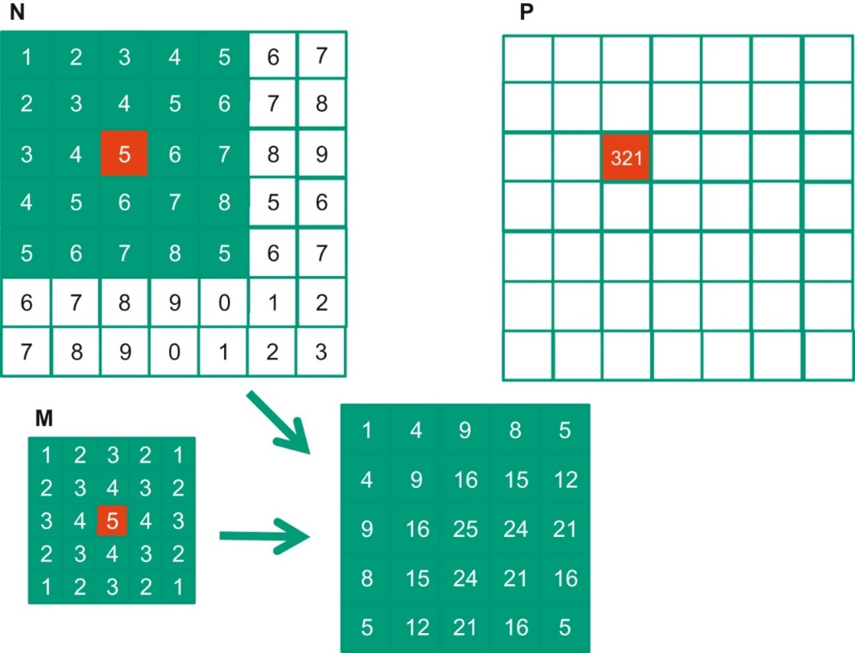
Parallel Patterns Summary
Convolution
Sparse matrix
Prefix sum (scan)
Histogram
Merge sort
Graph search

Slide 51
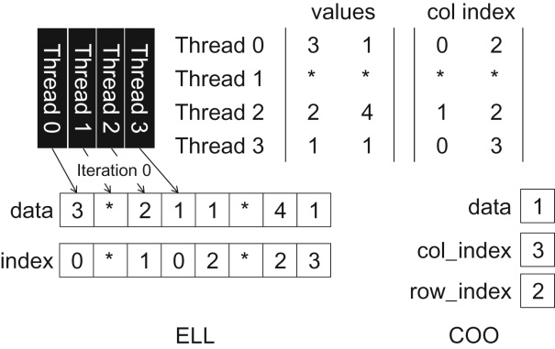
Parallel Patterns Summary
Convolution
Sparse matrix
Prefix sum (scan)
Histogram
Merge sort
Graph search

Slide 52
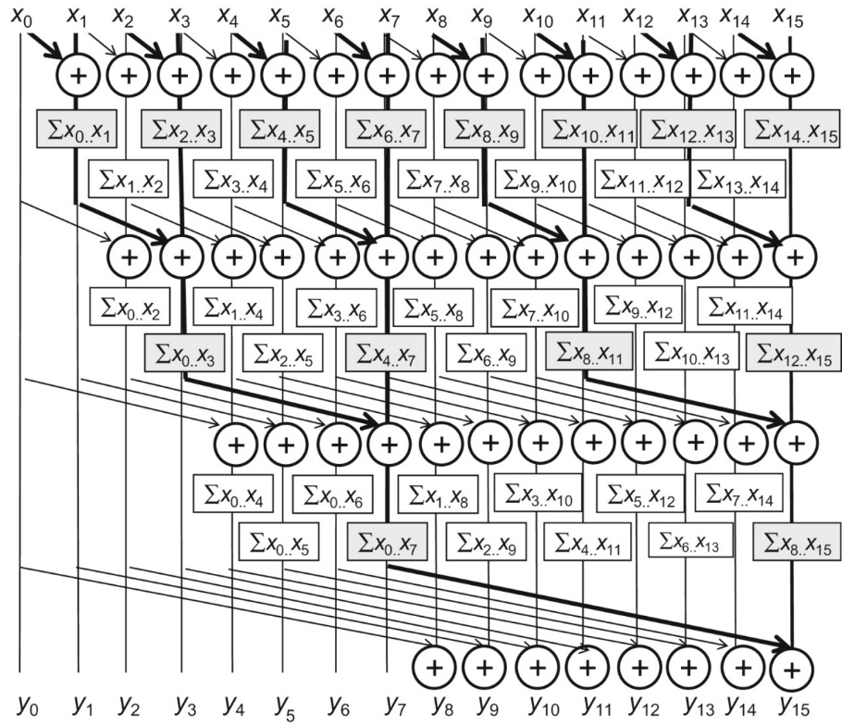
Parallel Patterns Summary
Convolution
Sparse matrix
Prefix sum (scan)
Histogram
Merge sort
Graph search

Slide 53
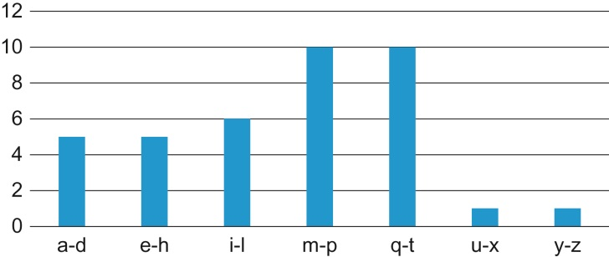
Parallel Patterns Summary
Convolution
Sparse matrix
Prefix sum (scan)
Histogram
Merge sort
Graph search

Slide 54
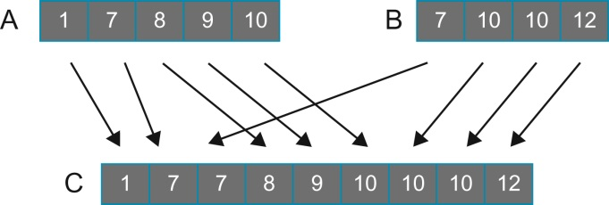
Parallel Patterns Summary
Convolution
Sparse matrix
Prefix sum (scan)
Histogram
Merge sort
Graph search

Slide 55
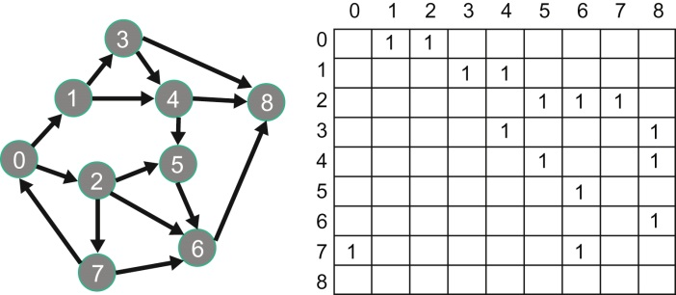
Parallel Patterns Summary
Convolution
Sparse matrix
Prefix sum (scan)
Histogram
Merge sort
Graph search

Slide 56
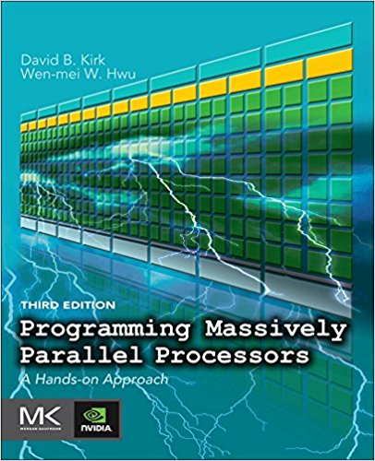
Reference
CUDA C Programming Guide,
https://docs.nvidia.com/cuda/cuda-c-programming-guide/index.html
Programming Massively Parallel Processors,
A Hands-on Approach
Third Edition
Chapter 10

